Slide 1
Medical technology in smart cars
IMT3591 – Assignment 1 – Group 5
Jonas Helbig Laodice Melliti

Slide 2
Introduction
State of the art
Our System
  PEAS Description
  System Architecture

Slide 3
Introduction
Goal: assist elderly or old people
  In-Car system
  Medical parameters
  Reaction to captured data
????????

Slide 4
A Preliminary Study on Driver's Stress Index
Long monotonous driving
Sensors capture
  Skin temperature
  Periphal resistance
  Normalized pulse volume
Actuators: Display, Computer

Slide 5
Physiological parameters variation
General driving simulation
Sensors capture
  Galvanic skin resistance
  Periphal temperature
  Heart rate variability
Actuators: Display, Computer
Long term goal: Learning agent system

Slide 6
In-Car Vital Parameter Acquisition and Processing
???

Slide 7
Our System
Calculate:
  Stress level
  State of consciousness
Workflow
  Capture medical data
  Worrying conditions -> Warn driver
  Dangerous conditions -> Emergency protocol

Slide 8
PEAS
Performance
Environment
Detect harmfull state
Appropriate reaction
  Warn driver
  Call ambulance
Car
  Esp. Steering wheel
Driver
External devices
(described in sensor)

Slide 9
PEAS
Sensors
Actuators
Medical sensors
  Blood pressure
  Heart beat
  Skin resistance
Other
  GPS
  Touch screen
Mobile phone
Speakers
Touch screen
(display)

Slide 10
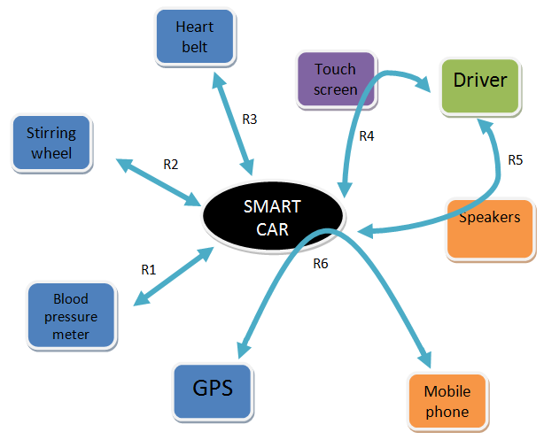
System Architecture
R1: gets the blood pressure
R2: gets the skin resistance
R3: gets the heart rate
R4: input: touch screen
R5: output: speakers
R6: contact ambulance
  uses the GPS coordinates

Slide 11
Thank you for listening
Any question?

